Slide 1
Team Spirit

Slide 2
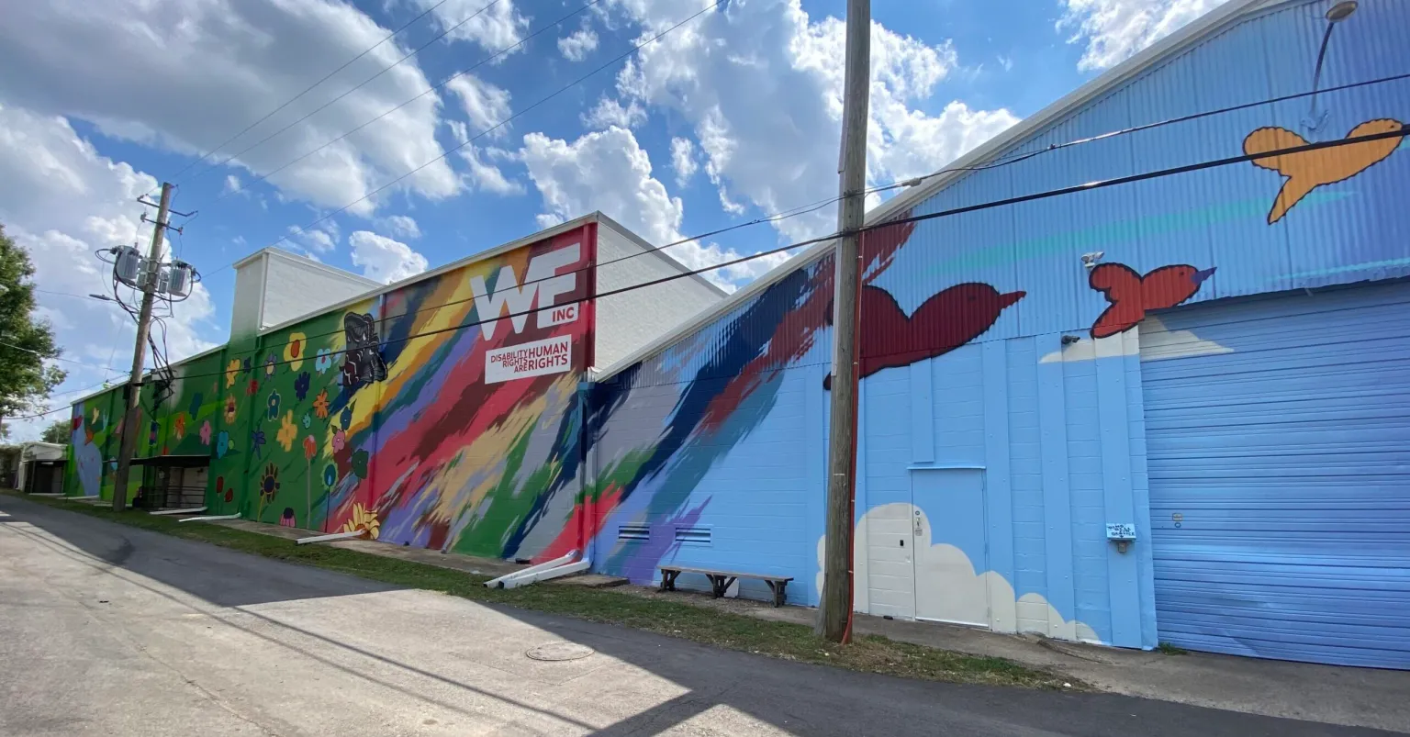

Workshops Empowerment Inc.
Notes:
“WE Inc. has deep roots in the Birmingham community, and their history makes them a respected presence in workforce development.”
“Their mission focuses on helping individuals who face barriers to traditional employment — including youth, people with disabilities, and others with limited opportunities.”
“Our project centers on identifying potential nonprofit partners that align with this mission and can expand WE Inc.’s impact without overwhelming their resources.” Any partnership we recommend has to be mutually beneficial — meaning it should help WE Inc. while also adding value to the partner organization.”
“We also have to keep WE Inc.’s limited capacity in mind. They run multiple programs with a small team, so any partner must fit realistically within what they can manage.”

Slide 3

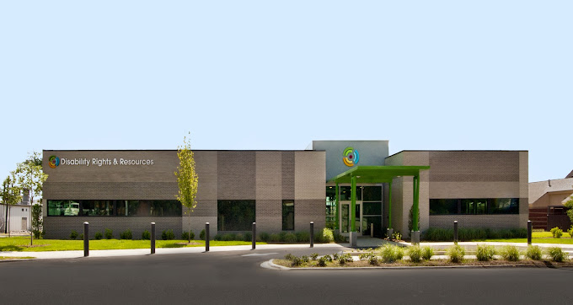
Disability Rights and Resources
Notes:
Disability Rights and Resources serves as a key resource center for Central Alabama, which allows them to reach and support a wide community.”
“Their approach centers on promoting self-advocacy and self-sufficiency, ensuring clients feel equipped to stand up for their needs and goals.”
“Their work is focused on individuals with disabilities, aligning closely with WE Inc.’s mission of supporting people who face employment barriers.”
“The organization is also deeply educational — offering training, guidance, and support that help clients build long-term independence.”

Slide 4
Previous Problem Statement
Focus Area:
Helping individuals facing barriers to employment, find jobs in the private sector.
Main Goal:
Scale up and hire more interns, in particular, young adults and those with disabilities.
Notes:
WE inc focuses on helping individuals with disabilities and individuals with employment blocks, find jobs in the private sector, however they are looking to grow by hiring more interns and continuing to grow in the nonprofit space.

Slide 5

Midterms Feedback
Make slides more professional
Drop Studio by The Tracks
Focus on getting on DRR reference list
Making marketing material for potential partners
Lunch and Learn

Slide 6
Problem Statement
WE INC. is a deep-rooted organization; however, this history has a negative perception that has created challenges.
Focus on marketing material to rehabilitate image aimed at potential partners
Create joint marketing with partners to increase enrollment
Notes:
Wanted to perhaps change the negative

Slide 7
Input and Output
Input​
DRR
Activities​
Output​
WE Inc.
Research DRR and We Inc.
Plan to contact DRR through an email
New marketing material for partners
Short Term: New WE Inc. image
Mid Term: Lunch & Learns
Long Term: Added to DRR resource list

Slide 8
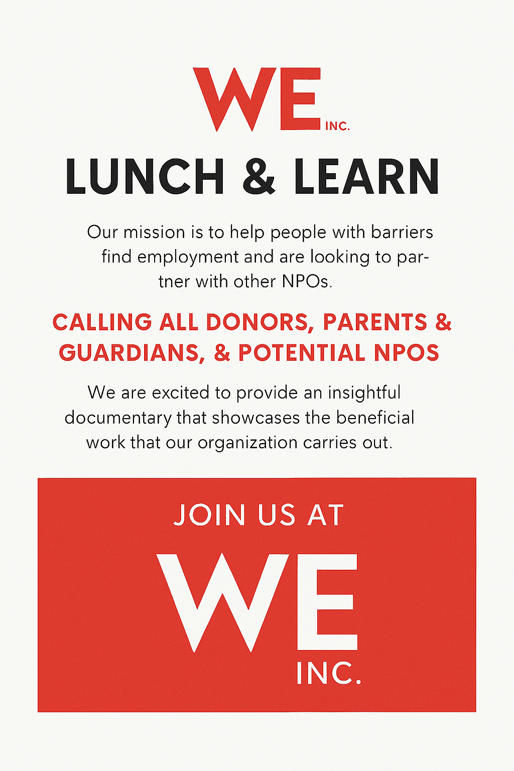
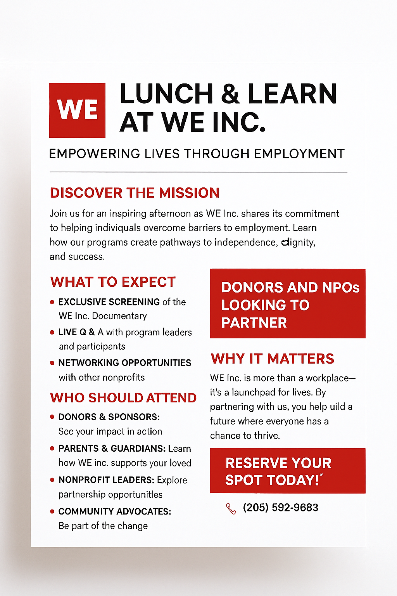
Brochure
Notes:
#2 Created with Co-pilot

Slide 9

WE INC. And DRR
Message: Building Self-sufficiency, self-agency, overall benefits of occupation
Audience: Focuses on the individual, parents, and guardians
Notes:
Change this flyer, mainly the colors. Need to also take away to "for parents and guardians of disabled individulas" part, as it takes away agaency from those with disabilities

Slide 10
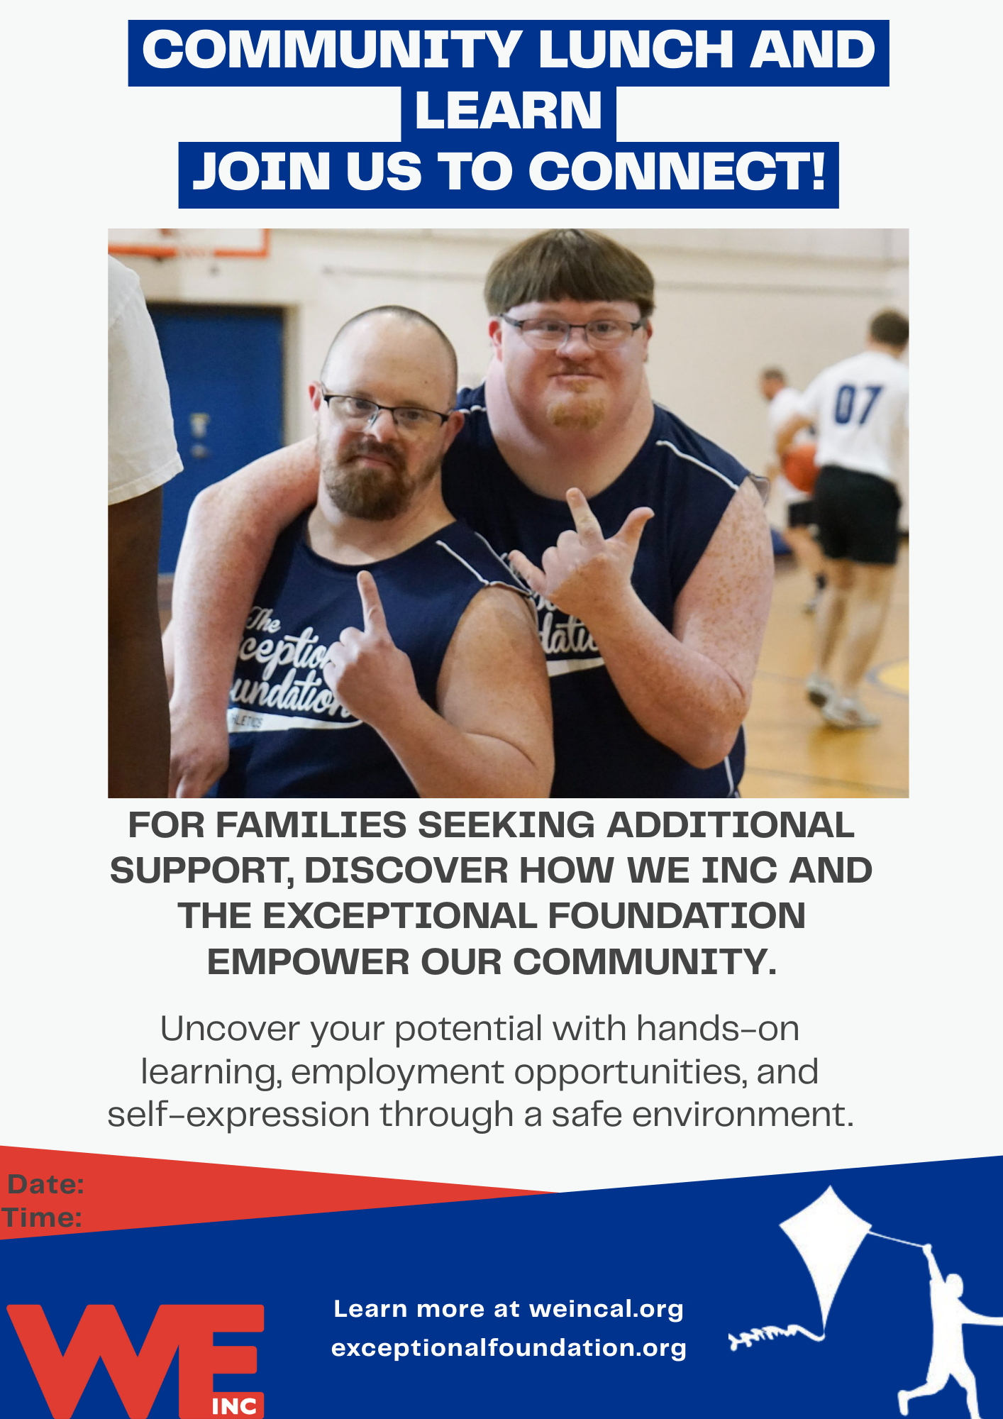
WE INC. and Exceptional Foundation
Message: Safe environment, Self-sufficiency, Self-development.
Audience: Focuses on the Individual, parents, and guardians
Notes:
Same issue as the previous flyer

Slide 11

WE INC. and Youth Towers
Message: Supportive paid job training, experience with barriers, extensive support networks
Audience: Focuses on potential donors
Notes:
Potential donors in the sense of "invest in the future of Birmingham through jobs training", as these kids have been left behind and not given a fair shot

Slide 12

WE INC. and One Roof
Message: Paid internship, supportive space, supportive staff, public transportation
Audience: Individuals helped by One Roof

Slide 13

We INC. and 100 Black Men of Birmingham
Message: Life skills through PRAES Lab, entrepreneurship.
Audience: Potential Donors

Slide 14
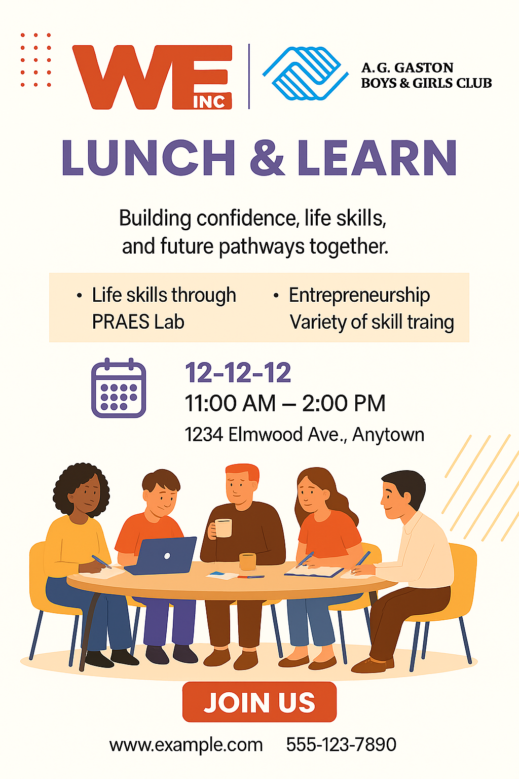
WE INC. and A.G. Gaston Girls and Boys club
Message: Life skills through PRAES Lab, entrepreneurship, variety of skill training
Audience: Potential Donors
Notes:
Want to focus on WE INC.'s start at entrepreneurship training, as it deeply aligns with A.G. Gaston. Focus on vast and diverse range of job training that could help people find potential passion

Slide 15
Surprising and Challenging
Communicating with potential partner
Attempting to refine the perfect message
Setting clear timelines

Slide 16
What we learned from this class
Concepts and skills
Problem solving
Teamwork
Strategic planning
Basics of consulting
Foundational knowledge of NPOs

Slide 17
What's Next?
Finish the Lunch & Learn flyer and finalize design
1
Submit updated marketing materials for long-term use
2
Share a list of potential partner organizations
3

Slide 18
Thank you

